Slide 1



PCGAN: Partition-Controlled Human Image Generation
Rui Wang, Dong Liang, Xiaowei Tian, Cong Zou
Institute of Information Engineering, Chinese Academy of Sciences
School of Cyber Security, University of Chinese Academy of Sciences

Slide 2
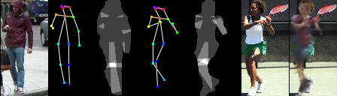
Goal
Source image
Target image
Transfer the person in the source image to the pose and background in the target image.

Slide 3
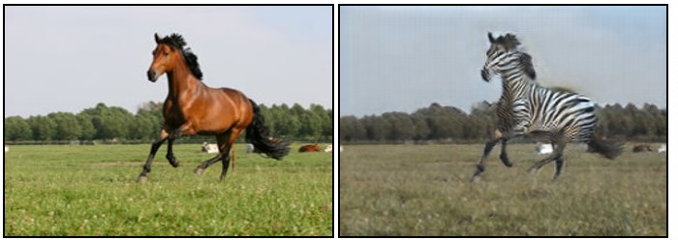
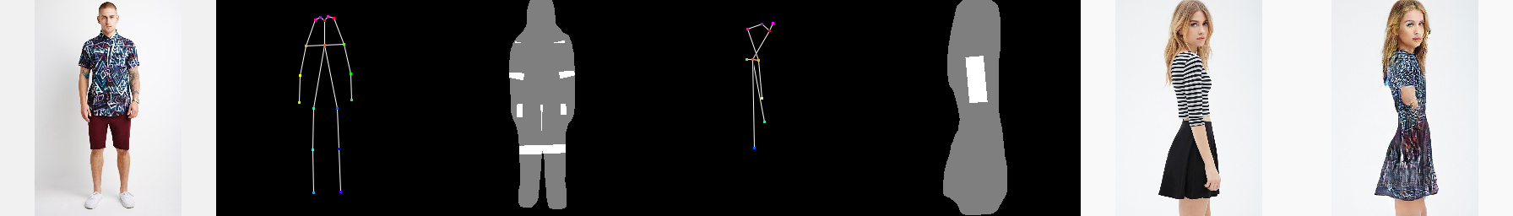
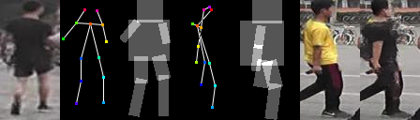
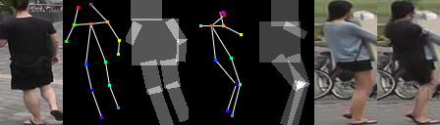
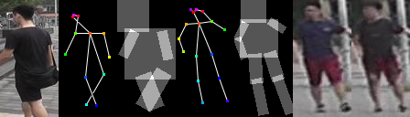
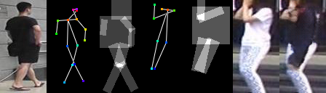
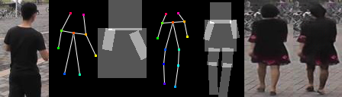
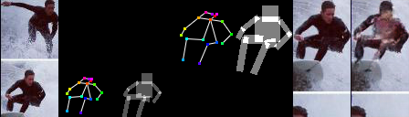
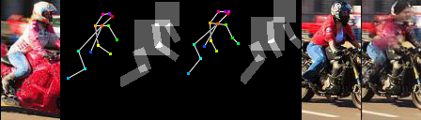
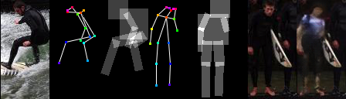
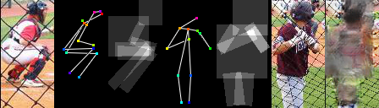
Challenges
Low tolerance rate for flaws in the human images;
Complex surrounding background;
Large spatial transformations.

Slide 4
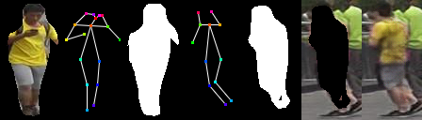
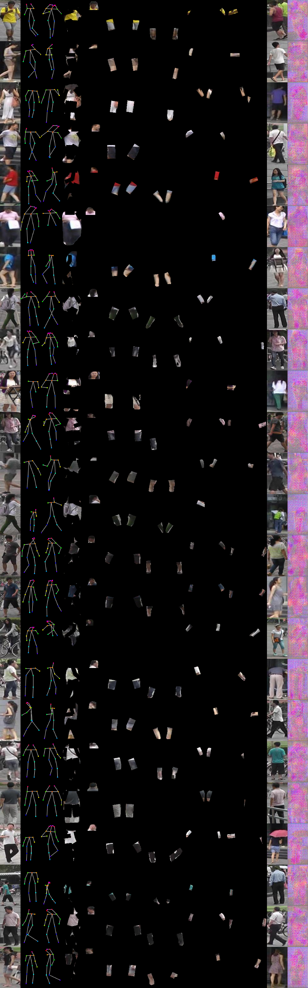
Observations
Human image can be partitioned into several parts.
Partition the image into foreground and background.
Partition the body sub-parts of the foreground person.

Slide 5
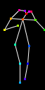

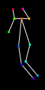

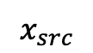
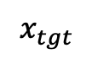
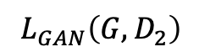
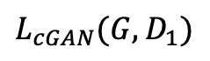
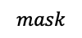
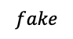
Partition-Controlled Human Image Generation
Fake
or
Real
$$L_{cGAN}(G,D_{1})$$
$$x_{src}$$
$$mask$$
$$fake$$
Fake
or
Real
$$L_{GAN}\left(G,D_{2}\right)$$
$$x_{tgt}$$
Generator
Discriminator

Slide 6
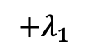
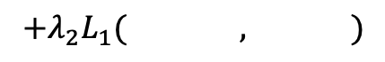
Partition-Controlled Human Image Generation
Fake
or
Real
$$L_{cGAN}(G,D_{1})$$
$$x_{src}$$
$$mask$$
$$fake$$
Fake
or
Real
$$L_{GAN}\left(G,D_{2}\right)$$
$$x_{tgt}$$
Generator
Discriminator
$$+λ_{2}L_{1}( , )$$
$$L=\min_{G}{\max_{D}{ }}$$
$$+λ_{1}$$

Slide 7

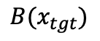
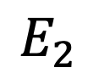

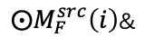


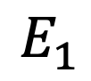
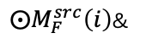
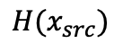
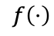


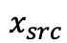


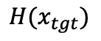
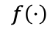
Generator: W-Net
$$x_{src}$$
$${H(x}_{src})$$
$$\hat{x}$$
$${B(x}_{tgt})$$
$${H(x}_{tgt})$$
$$feat(E_{1}_1)$$
$$feat(D_5)$$
$$feat(E_{2}_1)$$
$⨀M_{F}^{src}\left(i\right)$&
$$f\left(⋅\right)$$
…
…
$$E_{1}$$
$$D$$
$$E_{2}$$
$$feat(E_{1}_6)$$
noise
$$feat(E_{2}_6)$$
$⨀M_{F}^{src}\left(i\right)$&
$$f\left(⋅\right)$$

Slide 8

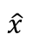
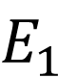
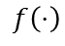

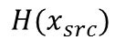
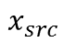


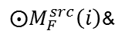

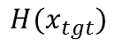
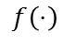
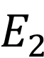

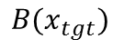
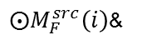
Generator: W-Net
$$x_{src}$$
$${H(x}_{src})$$
$$\hat{x}$$
$${B(x}_{tgt})$$
$${H(x}_{tgt})$$
$$feat(E_{1}_1)$$
$$feat(D_5)$$
$$feat(E_{2}_1)$$
$⨀M_{F}^{src}\left(i\right)$&
$$f\left(⋅\right)$$
…
…
$$E_{1}$$
$$D$$
$$E_{2}$$
$$feat(E_{1}_6)$$
noise
$$feat(E_{2}_6)$$
$⨀M_{F}^{src}\left(i\right)$&
$$f\left(⋅\right)$$

Slide 9
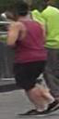

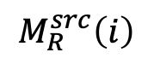
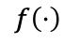
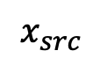
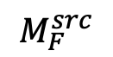










Human Body Transformation
$$f\left(⋅\right)$$
$$⨀$$
$$x_{src}$$
$$x_{tgt}$$
$$P\left(x_{src}\right)$$
$$M_{R}^{tgt}$$
$$M_{R}^{src}$$
$$M_{F}^{src}$$
$$x_{src}$$
$$M_{R}^{src}$$
$$M_{R}^{tgt}\left(i\right)$$
$$M_{R}^{src}\left(i\right)$$
$$f\left(⋅\right)$$
$$⨀M_{F}^{src}\left(i\right)$$
$$f\left(⋅\right)$$
Body sub-parts

Slide 10

Compared with the state-of-the-art

Slide 11





Compared with the state-of-the-art
$$x_{src}$$ | $$x_{tgt}$$ | Ma et al. 2017 | Ma et al. 2018 | Def. GAN | PCGAN

Slide 12
































Ablation study
LIP
COCO2017
Market-1501
$$x_{src}$$
$$x_{tgt}$$
Baseline
R-Mask
Full
$x_{src}$ | $$x_{tgt}$$ | Baseline | R-Mask | Full
$x_{src}$ | $$x_{tgt}$$ | Baseline | R-Mask | Full

Slide 13











Result visualization– Market1501
$$x_{src}$$
$$x_{tgt}$$
Results

Slide 14








Result visualization - DeepFashion
$$x_{src}$$
$$x_{tgt}$$
Results

Slide 15











Result visualization – COCO2017
$$x_{src}$$
$$x_{tgt}$$
Results

Slide 16










Result visualization - LIP
$$x_{src}$$
$$x_{tgt}$$
Results

Slide 17


Failure cases
Errors in HPE when given pose landmarks.
The mask region is so large that it cannot cover the expected body part.

Slide 18

Q & A.
https://github.com/AlanIIE/PCGAN

